Slide 1

Chapter 38: By Your Works Shall Ye Be Known
By Group 2:
Nidhishree Sanam
Shwetha Reddy Reddymalli
Sai Gangadhar Veeramreddy
Sai Manoj Kalasani
Sravani Ravulaparthi

Slide 2

Characters in the story
Story Recap
Stanley – Assistant
Ted – Manager
Drew Bolt – Group Manager of
Engineering.
One day, Mr. Marsh’s office needed an information about top technical contributors to compensate them properly.
Ted gave list of 21 outstanding contributors to Stanley and asked to determine whether or not the people on the list were being appropriately compensated.
Stanley started to do research and understood the company’s merit rating system.
After some research, he looked up Drew Bolt for one of Pawtucket’s finest was on the list.
The list was sequential and hierarchical, with four levels - Department, Group, Function and the division Manager.
He mentioned A.S. Baker was one of the guy from Bolt’s company that shocked about the person. He was not the one who was suggested by Bolt. They were Greg Mendel and Eve Curie.
He then confirmed with Bonnie, who knew just about everyone. She told A.S. Baker is a nice guy and whiz with words.
Then Stanley understood the whole process and came to conclusion that, the competent technician gets passed over and the one with the management flair, the one with look of a winner, comes out on top again.

Slide 3

Managerial Lessons learned
Reward to technical experts
Compensation of any employee.
What skills for employees does matter.
Perspective thinking of managers at different stages.

Slide 4

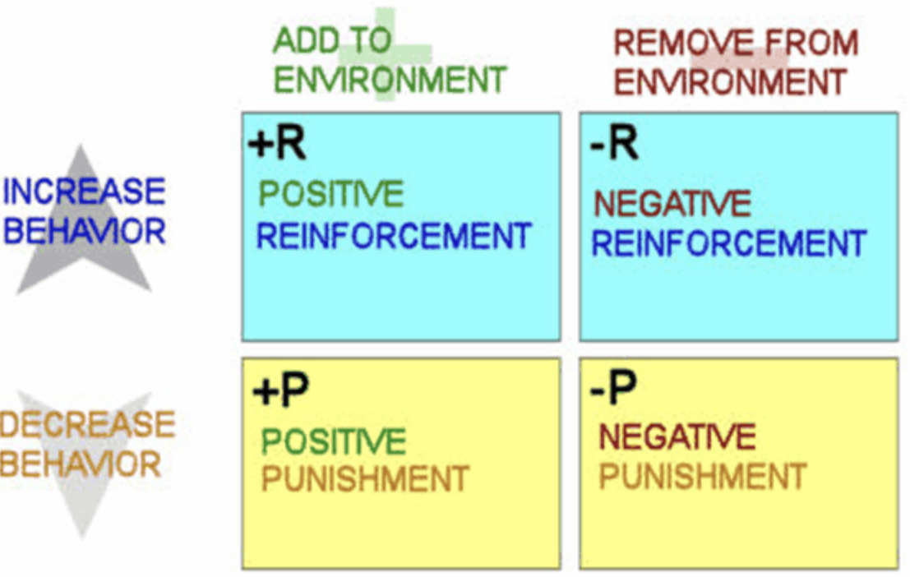
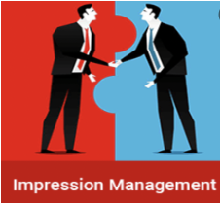
Theories
Organization Culture
Shared views, values, and attitudes developed by leaders within the organization define organizational culture, which in turn shapes how employees behave and perceive the organization.
Motivation & Reinforcement theory
Using rewards, punishments, and extinction, the reinforcement theory of motivation tries to motivate employees to reinforce the desired employee experience and behavior.
Impression Management
Impression management is a conscious or subconscious process in which people attempt to influence the perceptions of other people or objects by controlling information in social interaction.

Slide 5
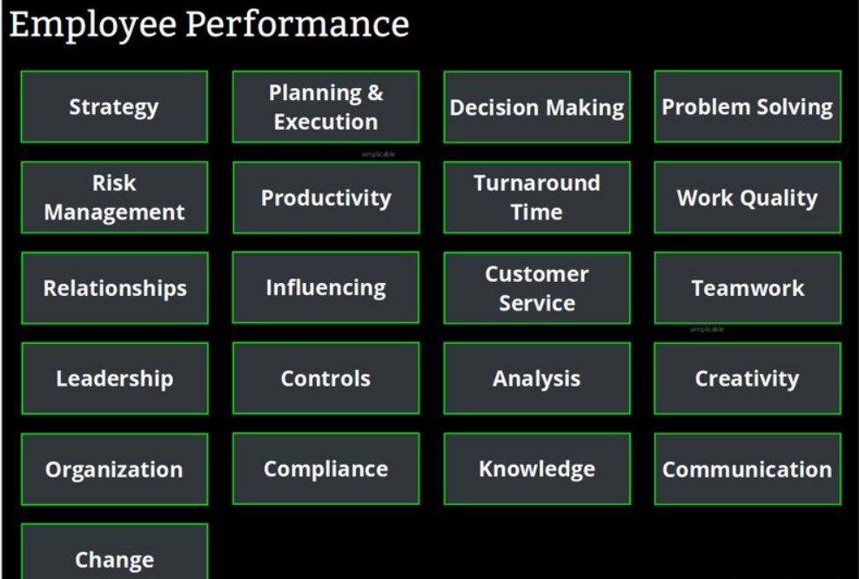
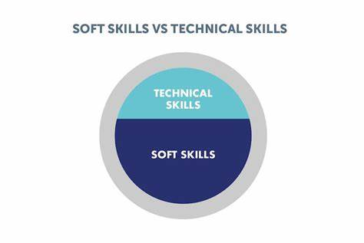
Additional Research
Employee Performance and growth:
There are in total 21 parameters on which any employee of an organization is analyzed.
Technical Skills vs Soft skills:
Cognizant implemented merit-based performance.
Pluralsight has stated that 52% of the employees are
showing interest in technical skills.
Hospitality companies need to have more soft skills rather than technical ones.
Google emphasizes its employees to be technical with good soft skills.

Slide 6

References:
The ropes to skip and the ropes to know_ studies in organizational theory and behavior-Chicago Business Press
Employee's motivation and compensation problems (ukessays.com)
State of Upskilling 2022 | Pluralsight

